Slide 1

Preparing to apply for secondary school

Slide 2

Key dates and information
Applications:
Open: Mid-July 2026
Closes: 31 October 2026
Notification 1 March 2027
Some facts:
It is NOT first come first served
Can (and should) apply for up to 6 places.
Only applying for one school does not make it more likely that you will get a place there. It means that if you do not get a place at that school, the council will choose a school for you because you did not specify a second, third, fourth etc choice of school. .
Apply to the council you live in. This includes if you are applying for a school in a neighbouring borough.
Only list a grammar school as a preference if your child has sat the entrance test (results in October 2026). Deadline to register 26 June 2026 4pm.
Form cannot be changed once submitted.

Slide 3
How to apply
Check the admissions policy for each school
Available via each school’s website (check policies section)
Check if your child meets the criteria (for example: EHCP, siblings, distance)
Not all schools offer sibling places and distance criteria varies
Look out for any additional requirements
For example: Sandwell Academy, Shireland Collegiate Academy and West Bromwich Collegiate require your child to sit a non-verbal reasoning test after applications are submitted

Slide 4
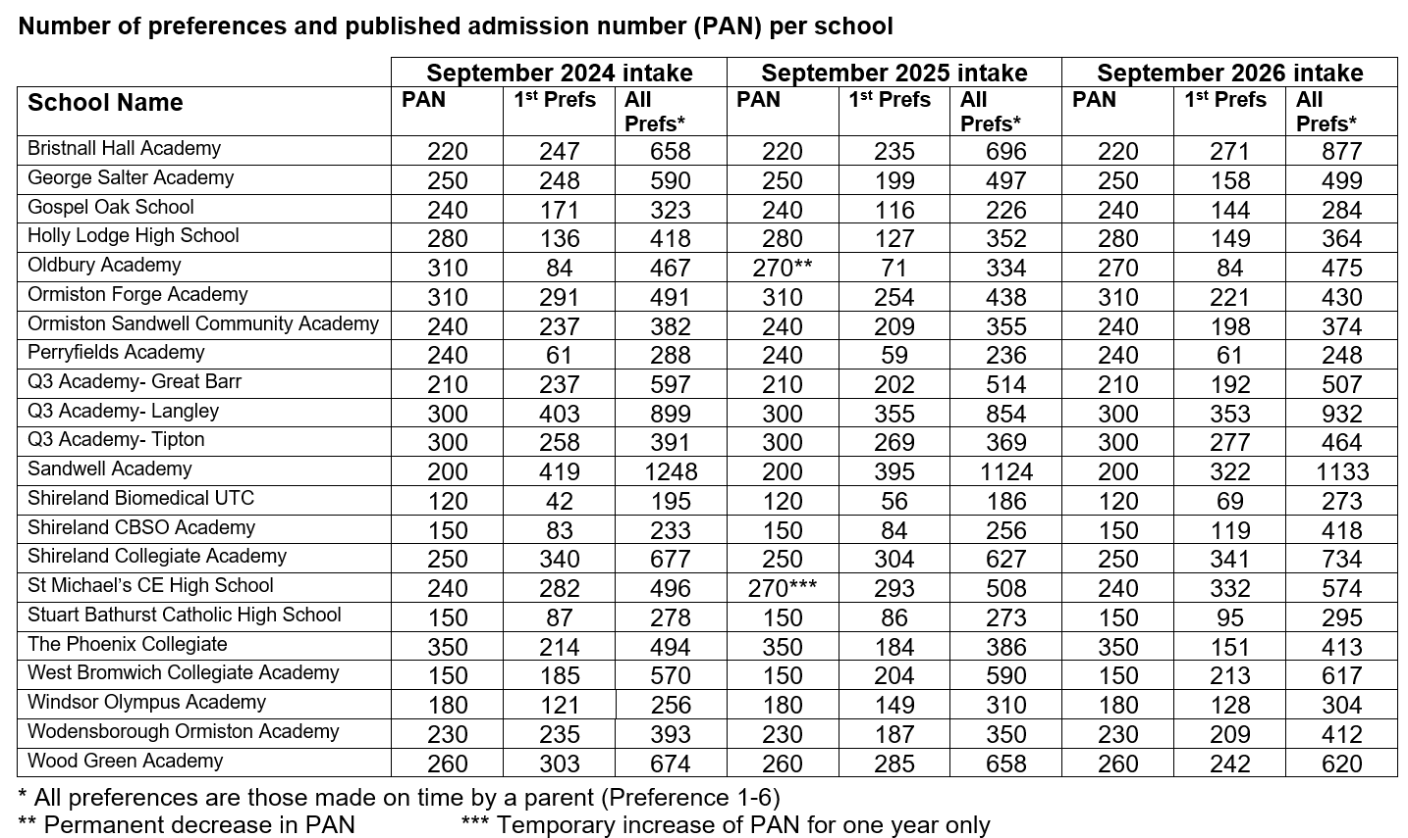
https://www.sandwell.gov.uk/downloads/download/203/secondary-statistics

Slide 5
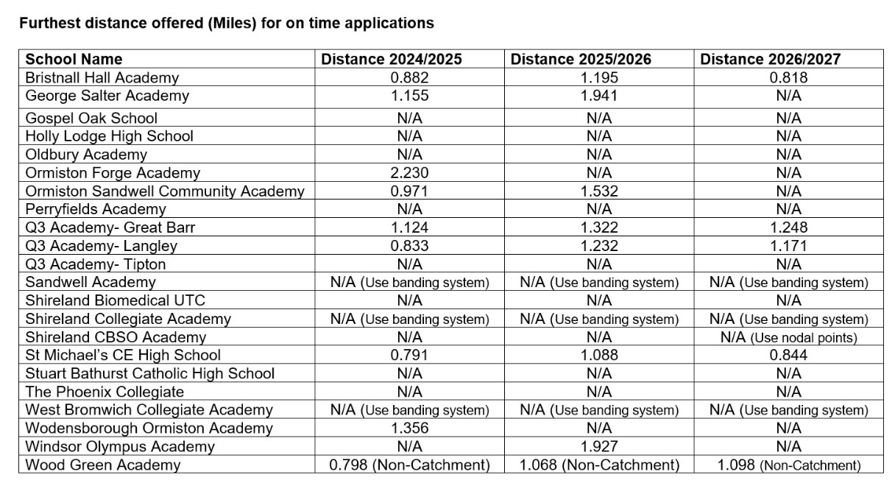

Slide 6
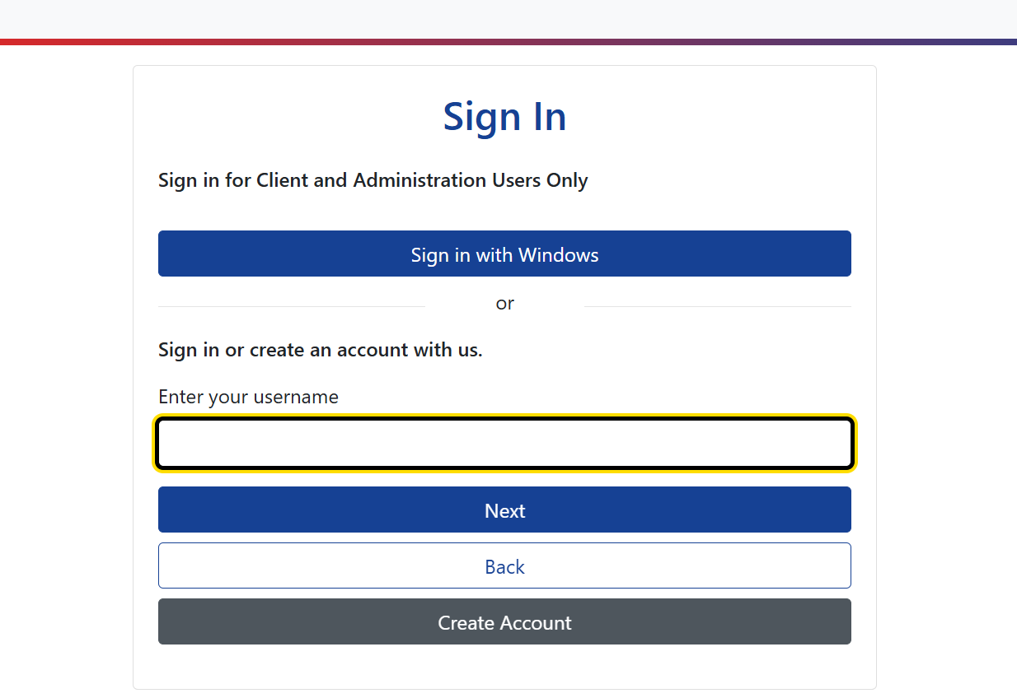
How to apply
www.sandwell.gov.uk
Click – Schools and education
Click – School admissions
Click – Apply for a school place
Click – Parent Portal
Account requires an email address to set up / log in
Enter parent details, child details, add one school at a time
DO NOT submit until you are 100% sure.

Slide 7
Sandwell schools with additional application forms
Aptitude:
George Salter (Arts Aptitude)
Shireland Collegiate Academy (Arts Aptitude)
Wood Green Academy (Sporting Aptitude)
Sandwell Academy (Sporting Aptitude)
Shireland CBSO (Musical Aptitude)
Windsor Olympus (Sporting Aptitude)
Denominational grounds
Stuart Bathurst Catholic High School
Medical grounds:
Holly Lodge High School
Oldbury Academy
Ormiston Community Sandwell Academy
Ormiston Forge Academy
Perryfields Academy
The Phoenix School
Wodensborough Ormiston Academy
Deadlines for additional forms can be as early as September. Additional forms go directly to the school. You must also complete the usual online application form to the council.
https://www.sandwell.gov.uk/school-admissions/applying-secondary-school

Slide 8
Appealing a school place
If you do not get the school you wanted:
Accept the place you have been given, even if it is not the school you want.
Download, complete and post appeals form (sandwell.gov.uk)
or appeal the decision online (My Sandwell)
You can only appeal for a place at a school that you put on your preference list
To appeal for Sandwell Academy, contact them directly
To appeal for a school outside of Sandwell you will need to contact the relevant local authority

Slide 9
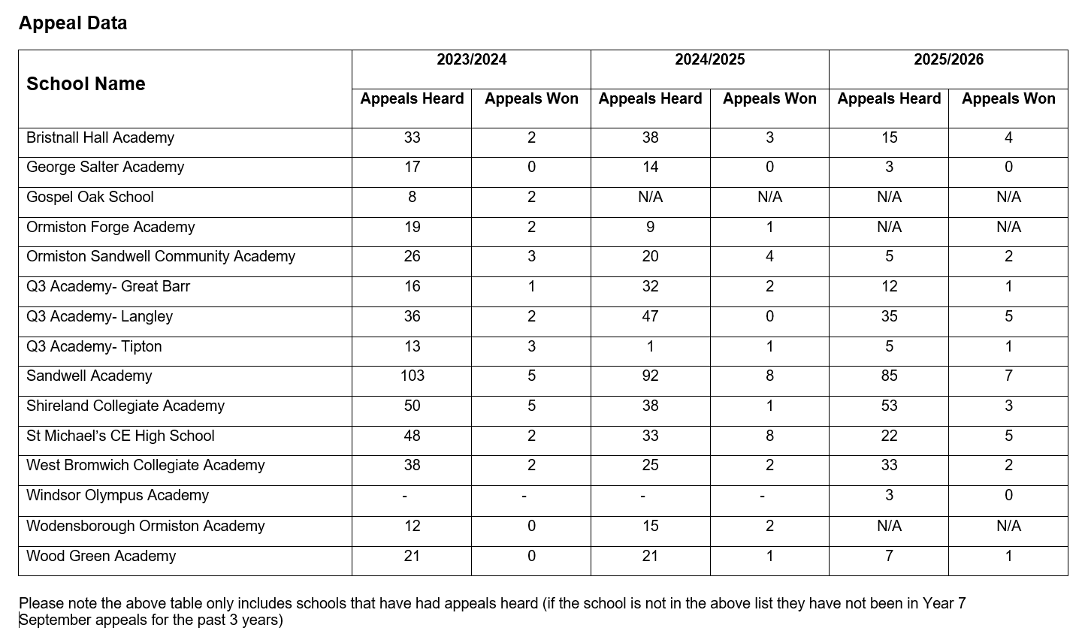

Slide 10
Hints and tips

Slide 11
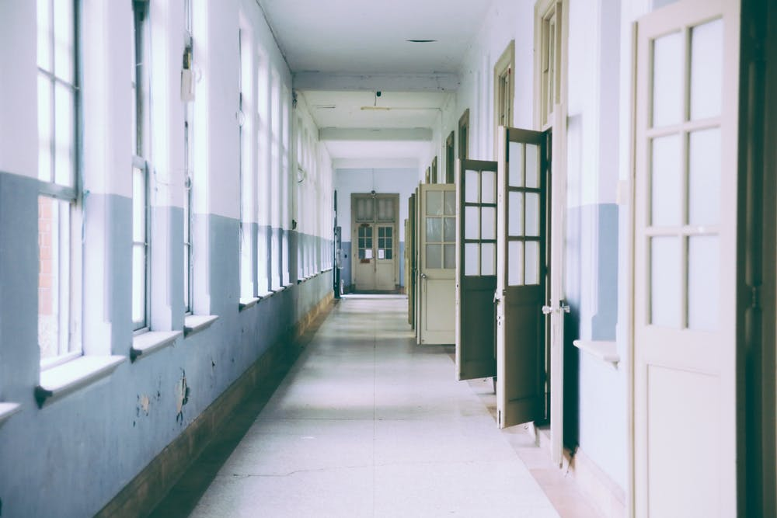
What to look for in a school
Open days
Open evenings
Tours

Slide 12

What to look for in a school

Slide 13



What to look for in a school
Practicalities

Slide 14


What to look for in a school
Pastoral staff
Form Tutor
Transition lead
Head of Year
SENDCO

Slide 15

What else to consider
Performance tables
https://www.gov.uk/school-performance-tables

Slide 16

What to look for in a school
Enrichment
School teams and clubs
Curriculum subjects
Personal development
Skills
Career information

Slide 17
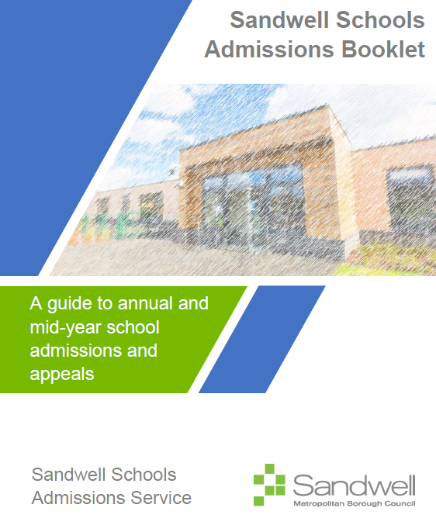
For more details
Sandwell School Admissions Booklet available on the sandwell.gov.uk website:
https://www.sandwell.gov.uk/downloads/download/201/parent-guide

Slide 18

Questions

